Slide 1
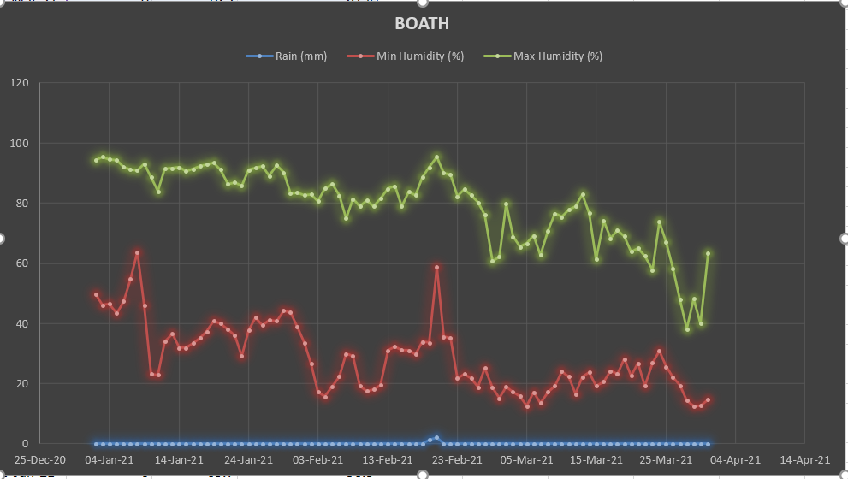
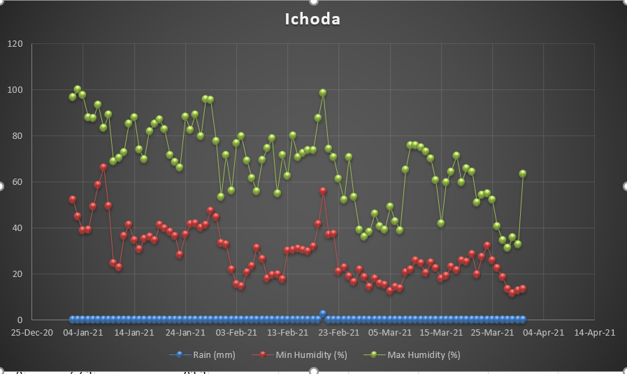
ANALYSIS OF RAINFALL AND WEATHER PATTERNS IN THE STATE OF TELANGANA
BOATH
ICHODA
We have chosen few selcted of Adilabad district for our analysis.Above graphs show rainfall and humidity in boath , ichoda , sirikonda and jainoor regions of Adilabad. Climatic factors such as season wise rainfall data, maximum temperature and minimum temperature, forest area, relative humidity and wind velocity are considered to study the rainfall analysis in various districts of telangana.

Slide 2
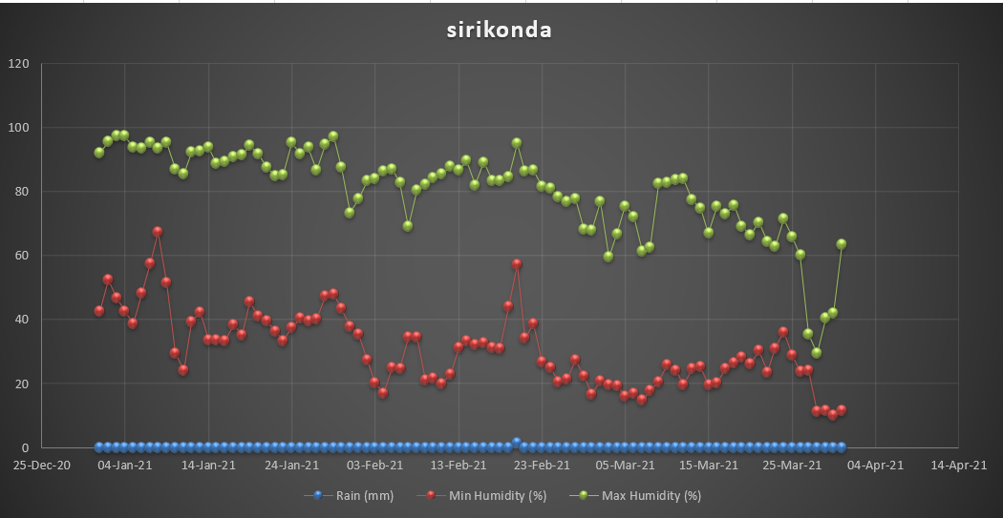
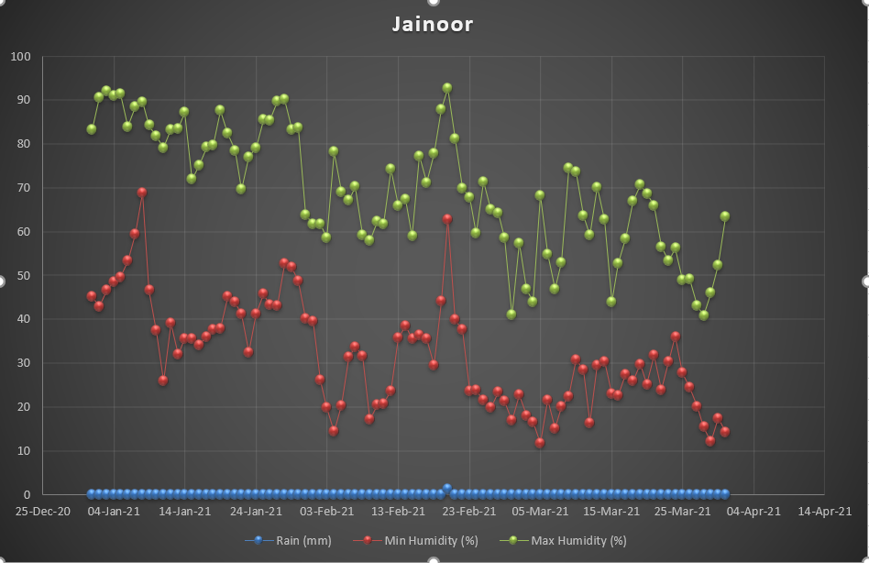
SIRIKONDA
JAINOOR
For statistical analysis rainfall data from a single series should ideally possess property of homogeneity - i.e. properties or characteristics of different portion of the data series do not vary significantly. Rainfall data for multiple series at neighbouring stations should ideally possess spatial homogeneity.The trends of annual maximum, minimum and average humidities were studied with respect to rainfall variation. It is observed from the analyses that, the rainfall is decreasing with the increase in annual average temperature. Annual humidity trends were also studied for each day in the year 2021.

